Slide 1
Hashing Lab
Review subsequent slides and complete the assignment as specified using Excel, Word or a tool of your choice
Use the following key values as your starting point –
15 54 13 10 135 114 49 174 27 24
No coding is required for this assignment
Include a small write-up highlighting your learning experience
You may find the following videos useful
https://www.youtube.com/watch?v=4YiQITXu_iM&t
Part 2 – 4 as well

Slide 2
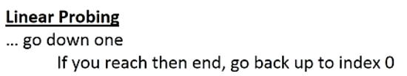
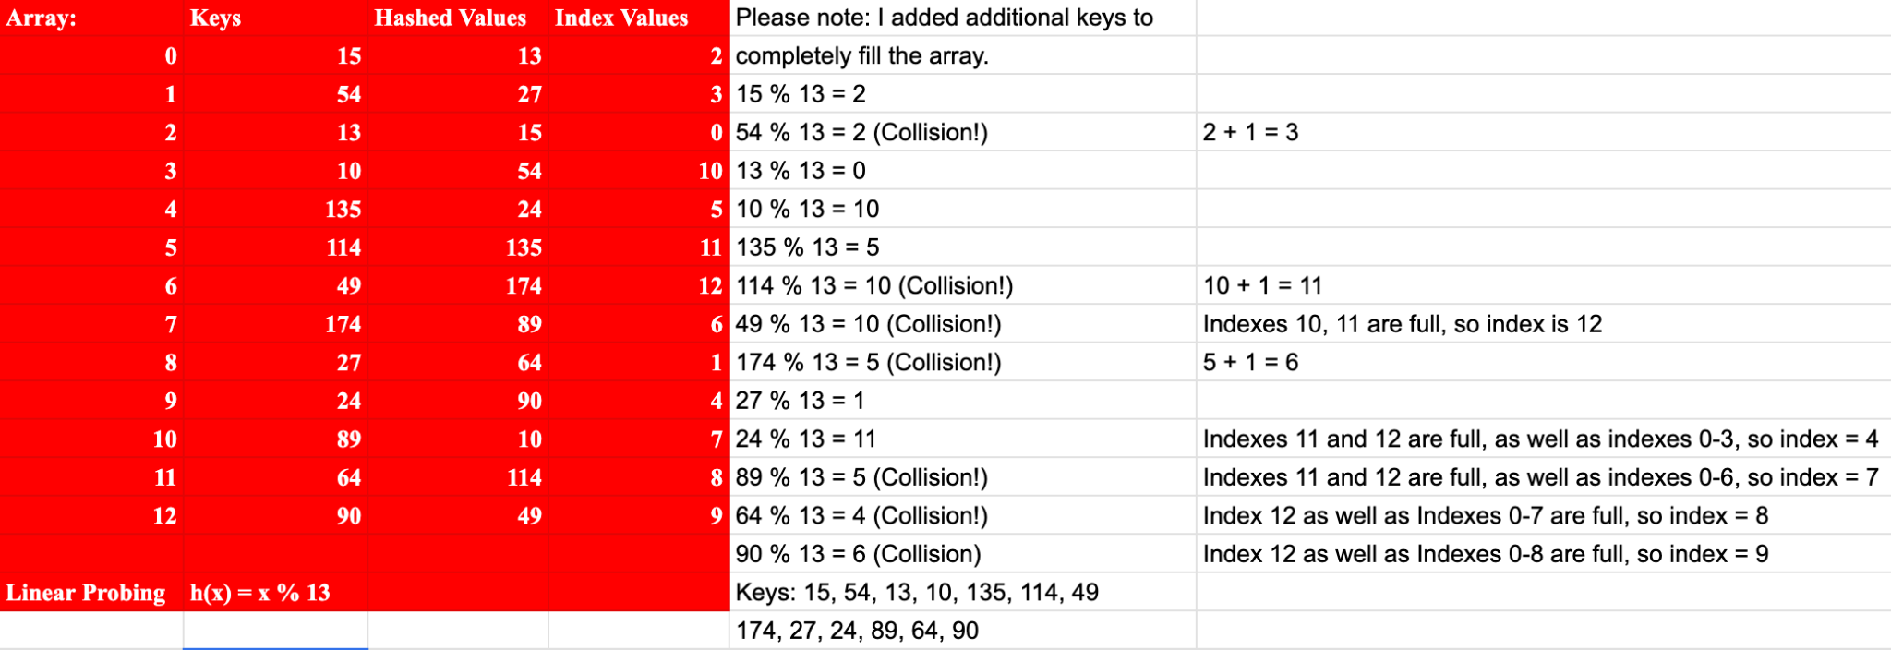
Create a hash table using open addressing with linear probing
N = 13
Array:
0
1
2
3
4
5
6
7
8
9
10
11
12

Slide 3
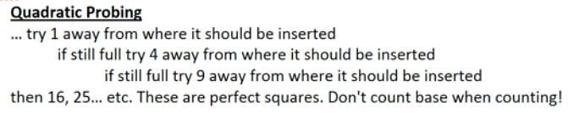
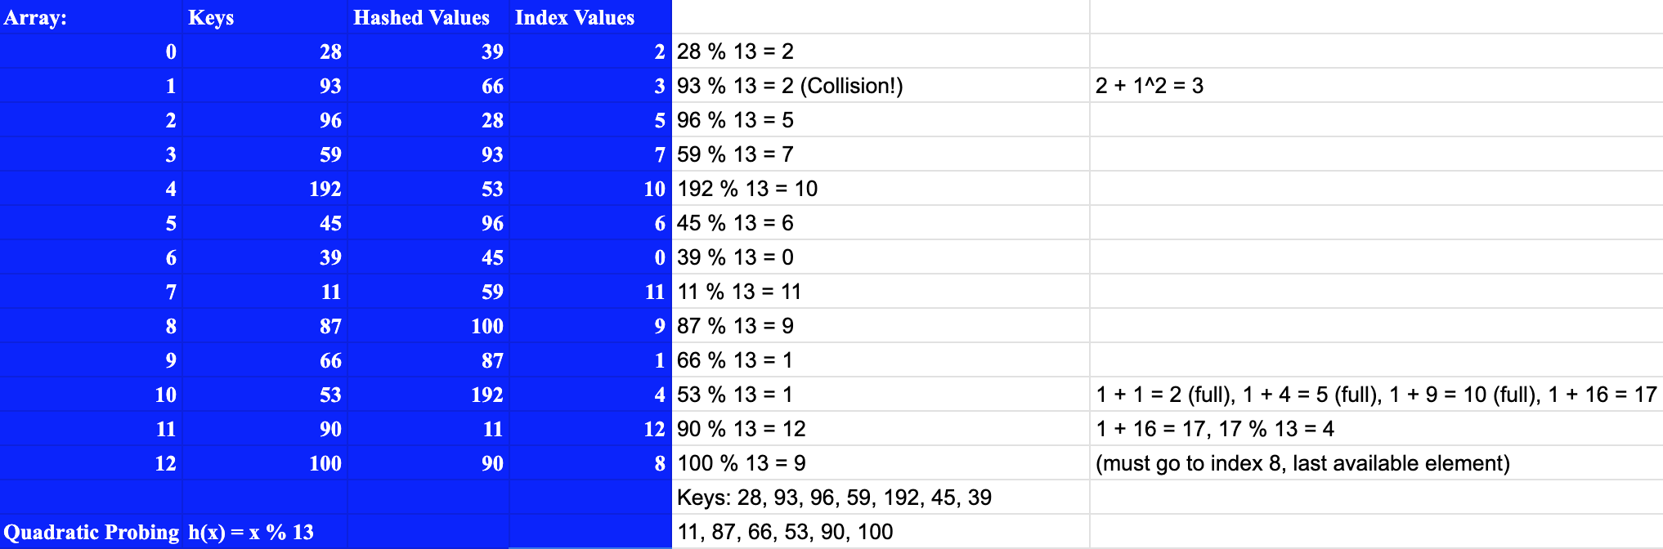
Using open addressing with quadratic probing
N = 13
Array:
0
1
2
3
4
5
6
7
8
9
10
11
12

Slide 4
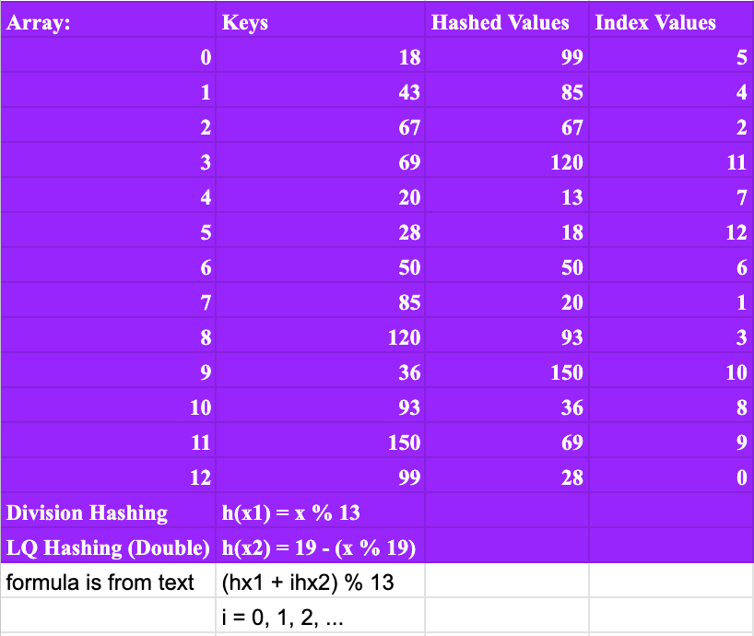
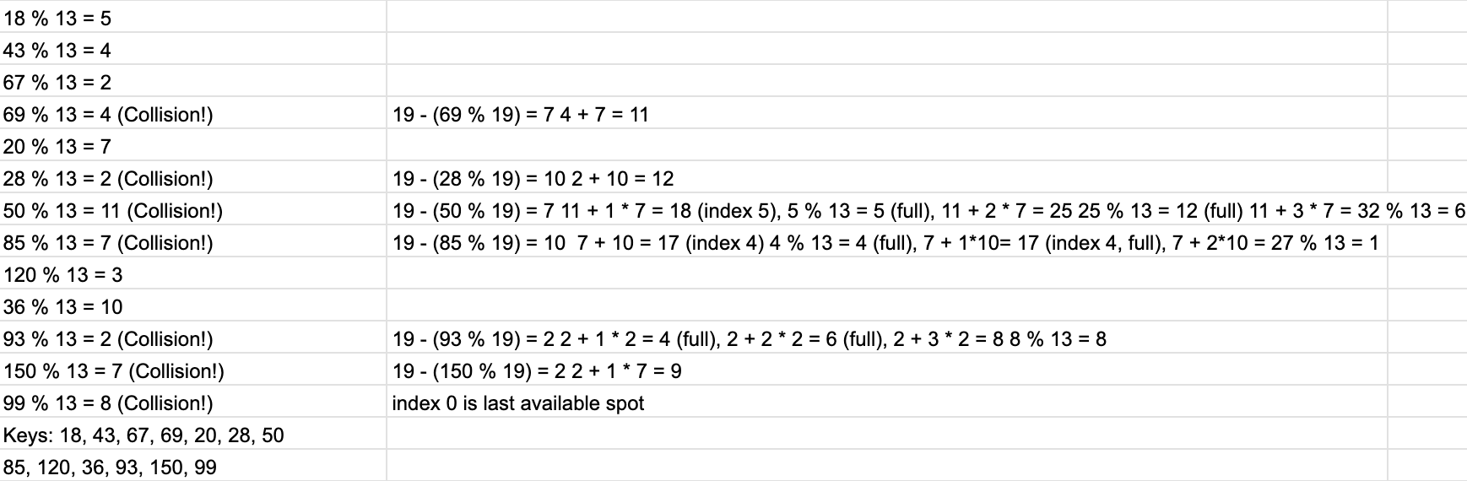
Using open addressing (division hashing) and the linear-quotient collision path algorithm
N = 13, 4k+3 prime = 19
LQHashing:
1. ip = pk % N
2. q=pk/N
if (q%N != 0)
offset = q
else
offset = 4k+3 prime
3. While collisions:
ip’ = (ip + offset) % N
4. Set Array[ip]=key
Array:
0
1
2
3
4
5
6
7
8
9
10
11
12

Slide 5
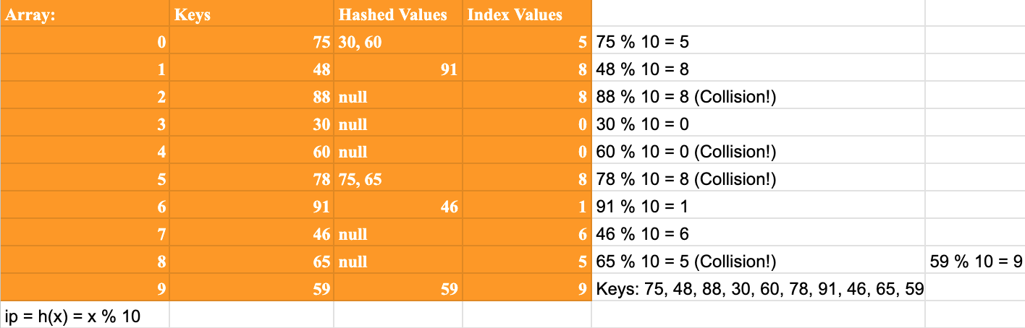
Bucket hashing where (N=10) and ip = (p_{k}) % N
Array:
0
1
2
3
4
5
6
7
8
9

Slide 6
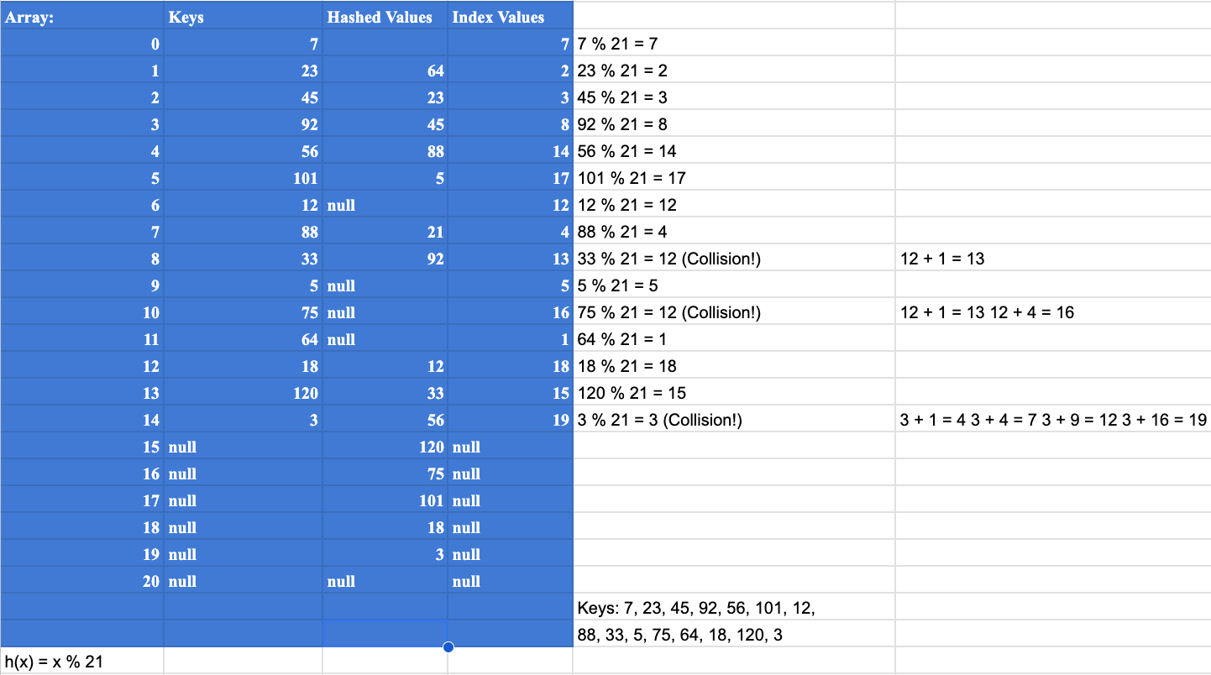
Repeat what you have done by using an open addressing algorithm of your choice
Come up with your own 15 keys and a 21-element array
Challenge yourself using an algorithm that you are most unfamiliar with to maximize your learning experience
Elements: 15
N = 21

